Slide 1
Data science week 19
Winter 2020 Data Science Cohort

Slide 2

Attendance code
Attendance code:

Slide 3
Let’s Talk

Slide 4
Agenda
Today’s Agenda:
Data Science and Society
Dimensionality Reduction/PCA
Why is it useful
How does it work
Drawbacks
Check-in: rest of the course schedule

Slide 5
Data Science and society
Data science/ML/AI still has tons of untapped potential
Lots of good being done
Lots of harm being done
Intent to control/suppress
Good intentions gone wrong
Lack of ethical standards/oversight
What can we do with our training and our work to apply ML/AI in just and equitable ways?

Slide 6
Bias in AI
Myth: decisions made by algorithms are more fair, because they remove the influence of human bias from the decision-making process
Reality: train on biased data -> learn biased predictions
This can happen even if you think you’ve taken out any problematic features
Hard to explain algorithms = hard to catch bias

Slide 7
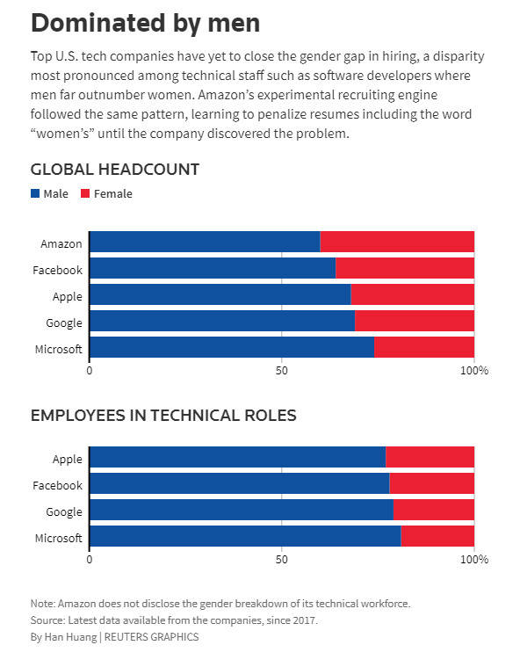
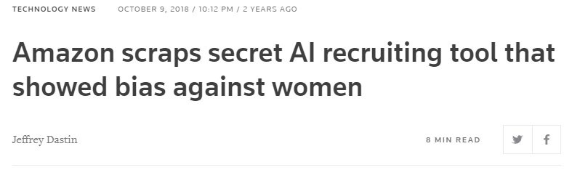
Bias in AI: Case study
Amazon:
The problem was not that gender was input as a feature

Slide 8

Bias in AI: Case study
Side note: how would you have caught that?
Explainability:

Slide 9
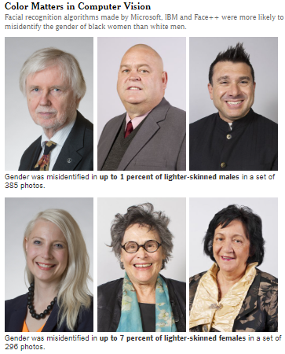
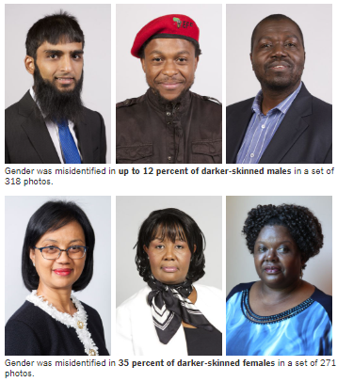
Bias in AI: Case study
Facial recognition algorithms:
2018 MIT study:

Slide 10
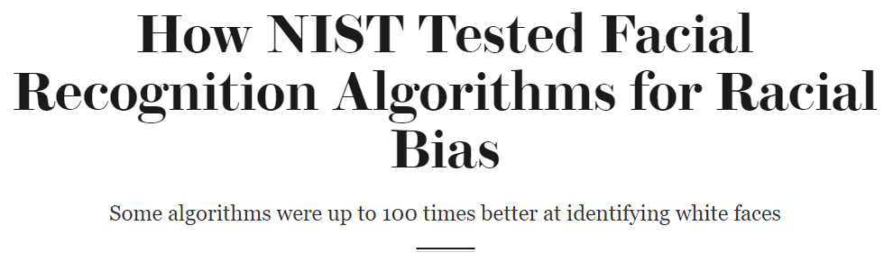
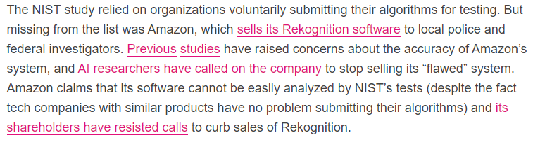
Bias in AI: Case study
Facial recognition algorithms:
2019 National Institutes of Standards and Technology (NIST):
Algorithms developed in Asian countries seemed to fare better with nonwhite faces. What did the report say about that?
What, specifically, it was talking about there was that algorithms developed in Asian countries didn’t have the demographic differentials for Asian faces. And what that indicates is there’s some promise that data that the algorithms train with could improve these performances. We don’t know, specifically, what the algorithm was trained on. We’re just making some level of assumption that the ones in Asian countries are trained with more Asian faces than most of the other algorithms.
So why haven’t developers in the U.S. trained their algorithms on more diverse faces?
When you get into these deep-learning and convolutional neural networks, you need large amounts of data and access to those data. That may not be trivial.
Source

Slide 11
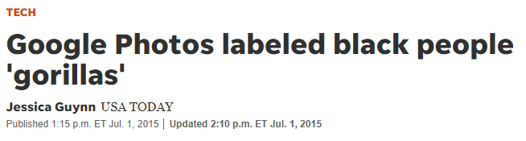
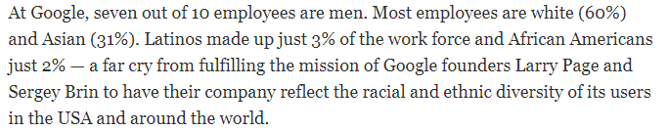
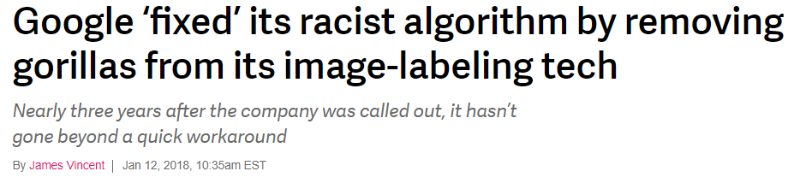
Bias in AI: Case study
Facial recognition algorithms:
Google
Source

Slide 12
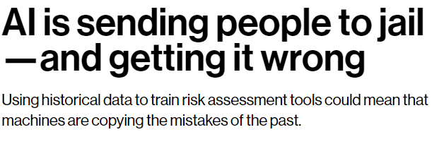
Bias in AI: Case study
Prison sentencing:
MIT Technology review:
“Risk assessment tools are designed to do one thing: take in the details of a defendant’s profile and spit out a recidivism score—a single number estimating the likelihood that he or she will reoffend. A judge then factors that score into a myriad of decisions that can determine what type of rehabilitation services particular defendants should receive, whether they should be held in jail before trial, and how severe their sentences should be. A low score paves the way for a kinder fate. A high score does precisely the opposite.”
“You may have already spotted the problem. Modern-day risk assessment tools are often driven by algorithms trained on historical crime data. […] Now populations that have historically been disproportionately targeted by law enforcement—especially low-income and minority communities—are at risk of being slapped with high recidivism scores. As a result, the algorithm could amplify and perpetuate embedded biases and generate even more bias-tainted data to feed a vicious cycle. Because most risk assessment algorithms are proprietary, it’s also impossible to interrogate their decisions or hold them accountable.”

Slide 13
Bias in AI: Summary
Some problems that perpetuate bias in ML/AI
Non-representative training sets
Training sets from a biased society
Low explainability
Because ML algorithms can inherently be hard to interpret
Because proprietary companies don’t always release their code, trained models, or training sets
Underrepresentation in tech

Slide 14
What can we do?
Ask the right questions
Am I building a tool that could be used for unjust purposes? What will the impacts of my generated predictions be?
Am I training on biased data? Can I find more representative datasets? Will I perpetuate biased systems with the training data I use?
How to combat AI bias
Understand how ML/AI works and use those skills to counter nefarious uses

Slide 15



Case study: good vs evil
Bots
Russian Twitter bots in the 2016 election
Twitter examples:

Slide 16
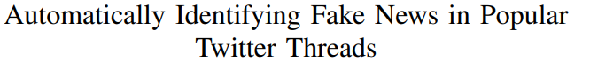
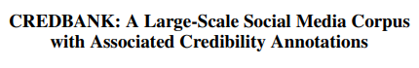
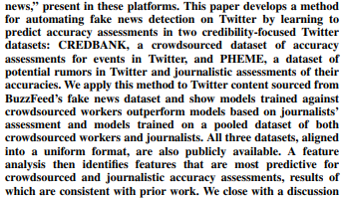
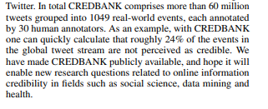
Case study: good vs evil
Bot detection
AI can distinguish between bots and humans based on Twitter activity
Source
Source

Slide 17
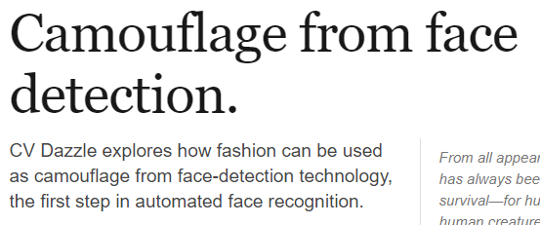



Case study: good vs evil
Facial recognition algorithms
Surveillance in Hong Kong, Clearview AI
Detection evasion
https://cvdazzle.com/ | a day using it

Slide 18

What can we do?
Links:
Data for Black Lives: http://d4bl.org/
Black in AI: https://blackinai.github.io/
https://www.datakind.org/ (need to be near a local chapter to volunteer)
https://www.drivendata.org/competitions/

Slide 19
Principal Component analysis

Slide 20
PCA
What is PCA?
X Supervised learning
X Unsupervised learning
✔ Dimensionality reduction technique

Slide 21
PCA
A short summary of PCA:
PCA lets us keep a lot of information about our input features while reducing the overall number of features
It does this by finding new dimensions to project the data onto, in a clever mathematical way that lets you combine feature information

Slide 22
PCA
Why is PCA useful?
Memory: store fewer features
Compute speed: run algorithms over fewer features in every row
Data visualization: make >2D data into 2D
Some caveats – limited use when your data gets too big, and you aren’t plotting feature vs. feature anymore
Fight the curse of dimensionality

Slide 23
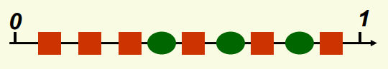
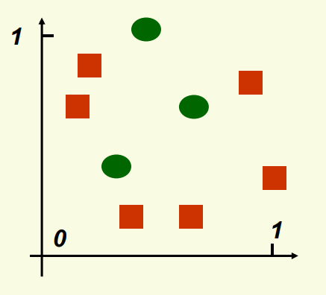
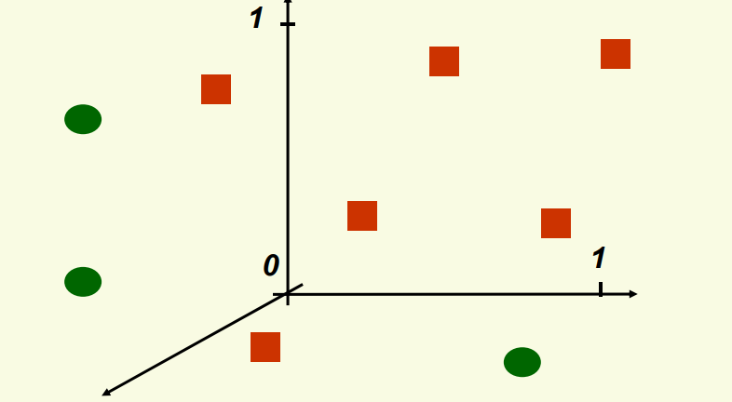
A brief aside about dimensionality
Curse of dimensionality:
One feature, 9 data points:
Two features, 9 data points
“If n samples is dense enough in 1D, then in d dimensions we need n^{d} samples! (Source)
Three features, 9 data points

Slide 24
PCA
How PCA works:
(Step 0: scale your features)
Step 1: find a vector that maximizes the variance in your training set/minimizes projection error. This new vector is called a Principal Component
Step 2: project the data down onto the Principal Component
Step 3: find the next PC the same way, with the additional caveat that the next PC is completely uncorrelated to the first one
Step 4: repeat step 3 until you’ve lost too much variance

Slide 25

PCA
Step 1: find the first PCA
We are looking for a dimension that maximizes the variance of the data. What does this mean?
https://setosa.io/ev/principal-component-analysis/
https://builtin.com/data-science/step-step-explanation-principal-component-analysis

Slide 26
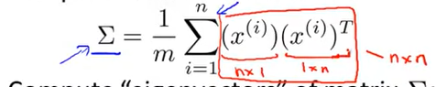
PCA
Step 2: project the data down onto the Principal Component
PCA finds the covariance matrix: an n x n matrix where each element represents the covariance between two features
Then it gets the eigenvectors (U) of the covariance matrix
Eigenvectors are more linear algebra than we’ll cover, for now, all you need to know is that the eigenvectors give you the axes directions where you get the most variance

Slide 27
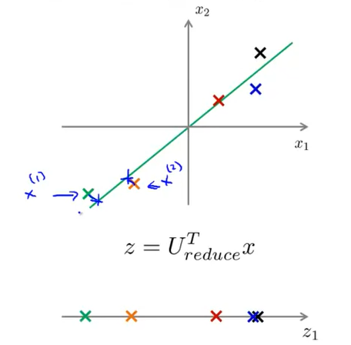
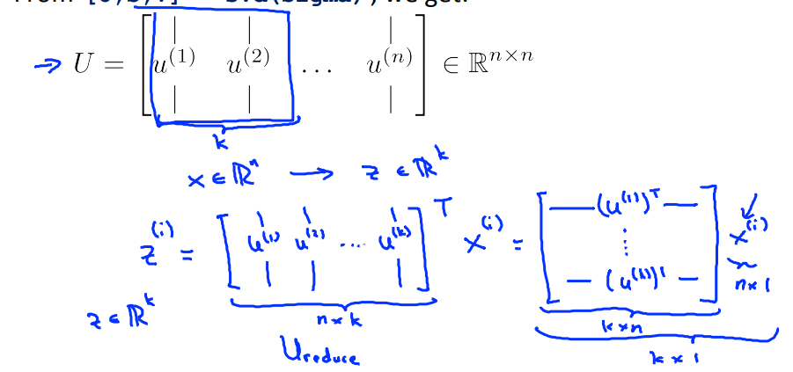
PCA
Step 2: project the data down onto the Principal Component

Slide 28
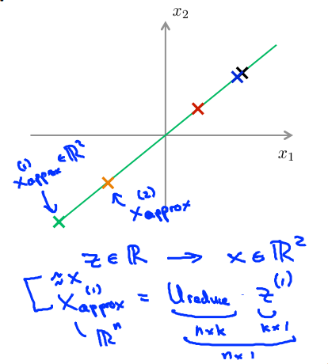
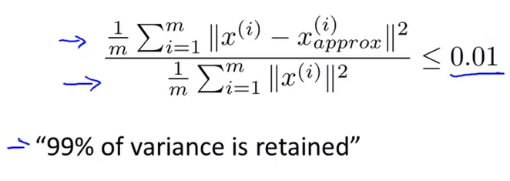
PCA
Steps 3 and 4: generate principal components until you lose too much information

Slide 29
PCA
If the mathematical details are overwhelming, don’t worry. If the concepts of dimensionality reduction generally make sense, see how you feel when you get to see it in Python with the in-class assignment.

Slide 30
Caveats
Caveats and drawbacks for PCA:
Principal components are mysterious and inexplicable
E.g., the principal component along which you collapsed your height and weight features is neither height nor weight nor an explainable combination of the two
Remember: map to PCs on your training data and apply the same mapping to validation and test! Do not generate new PCs for each dataset!

Slide 31
Course check-in

